Slide 1
382N.1: Computer Architecture Fall 2018: Lecture 10
Dam Sunwoo
University of Texas at Austin
Arm Research

Slide 2
Announcements
Lab 3 posted – Due Oct 21, 2018 at 11:59pm
Cycle-accurate simulator of LC-3b
Individual
PS #3 – Will be posted soon (Due Oct 17 before class)
PS #1 – check Gradescope for scores
Exam 1
5pm on Wednesday, Oct 10 in class
Will cover everything we learned including today’s lecture
Open-book including lecture notes (No internet searches or communication!)
Monday, Oct 8
Q&A: Review topics based on request
Otherwise, will talk about Physical Memory

Slide 3
Tomasulo Dispatch/Issue/Execute/Complete
If reservation station available before renaming
Instruction + renamed operands (source value/tag) to reservation station
Only rename if reservation station is available
Else????
When waiting for operand (implying tag in RS)
Watch common data bus (CDB) for tag
When tag seen, grab value
When both operands available, instruction ready to be issued
Issue instruction to FU
After instruction finishes in FU
Arbitrate for CDB
Put tagged value onto CDB
Register file on CDB
Register contains 1 tag indicating latest value
If latest value of register seen, write to register (and set valid bit)
Reclaim rename tag
no valid copy of tag in system!

Slide 4
Register File Valid?
Set to invalid the moment dispatched as destination
At that point no following instructions should read the old value
Set to valid during writeback/complete iff tag matches instructions and register file location
Every instruction must maintain its original destination architectural register name
Every instruction must maintain its tag

Slide 5
Determining Order Reorder Buffer == Completion Buffer
Reorder buffer tracks all outstanding instructions in issue order
Determines when instruction becomes oldest
Retires oldest instruction(s) by copying pending value to architectural register file
If need to rollback to oldest instruction, throw away
Bread crumbs to determine state of each instruction
Similar to scoreboard
5
Notes:
5

Slide 6
Out-of-Order Execution => In-Order State Update
One possible strategy
Architectural registers
Consistent with in-order execution
AND separate rename registers
Hold non-completed values
value
valid
A
10
F
B
11
T
C
12
F
Value
Tag
committed
D
13
F
R0
0
T
E
15
F
R1
1
T
F
18
F
R2
2
B
F
G
25
F
R3
3
A
F
“RAT”
What registers are architectural registers?
Can R3’s value be read? If so, what is it?
Can R0’s value be read? If so, what is it?
Can R2’s value be read? If so, what is it?
How many rename registers required?
6
Notes:
6

Slide 7
Possible Reorder Buffer – Implemented as Circular Buffer
Valid
Issued
Done
Inst address
Arch Reg
Rename
Reg
head
1
1
0
0x0100
---
---
1
0
0
0x0200
R3
B
1
1
1
0x0204
R5
A
tail
0
0
0
0
0
0
0
When can an instruction retire?
What do you do?
How do you read a register that hasn’t committed to arch state?
7
Notes:
7

Slide 8
Possible Reorder Buffer – Implemented as Circular Buffer
Valid
Issued
Done
Inst address
Arch Reg
Actual
Physical
head
1
1
0
0x0100
---
---
1
0
0
0x0200
R3
Value
1
1
1
0x0204
R5
Value
tail
0
0
0
0
0
0
0
When can an instruction retire?
What do you do?
How do you read a register that hasn’t committed to arch state?
8
Notes:
8

Slide 9
Nonblocking Caches
Needed to allow “memory parallelism”
Concurrent requests to memory so that OOO isn’t blocked
Concurrent requests to utilize throughput optimizations in mem
Miss Status Holding(Handling) Registers (MSHRs)
Track each outstanding memory operation
Fixed number of outstanding misses at each level
Multiple requests can potentially be serviced by same entry
Implies data returns out of order – need an ID and buffers at all levels where non-blocking allowed
CPU
L1$
L2$
Mem
MSHR

Slide 10
Shadow Memory Buffers/Store Buffers
Uncommitted executed memory writes are blocked to a write buffer until instruction is committed
Loads must be short-circuited from buffer
When instruction is oldest, writes either
Allowed to proceed to be written to memory or
Canceled
Store buffers are essentially renamed registers for memory locations
Any issues?
Also known as the Load/Store Queue (LSQ)
Also known as Memory Ordering Buffer (MOB)

Slide 11
Shadow Memory Buffers/Store Buffers
Store → Load is potential RAW! True data flow
Store → Store is potential WAW
What about WAR?
Don’t want to stall on every memory operation
Rules for “memory disambiguation”
Loads (most relaxed)
Load can bypass any store known to not be to overlapping location
Careful about word size
Typically need to know addresses of load and all prior stores, unless:
Load can immediately “execute” when closest store to same address has a value (in store buffer)
Stores (most relaxed)
Store can write to memory when all older store addresses known

Slide 12
Where is the Reorder Buffer?
Fetch
Decode
Rename/ROB/ MOB/RS
RS/Schedule
Execute/Mem
WB
Retire
Retire stage also known as commit or gradute

Slide 13
Alternative: Explicit Register Renaming
Committed?
Committed
Tag
Uncommitted
Tag
Valid?
R0
P0
P4
C
T
No architectural registers, only physical registers
Use more physical registers than ISA supports
Supports in-order view of register values
Single register file, simpler
Used in MIPS R10000, Alpha 21264, and with many modern processors
Architectural register mapping is a lookup table
Committed or uncommitted
Valid or not
Can committed be invalid?
R1
P7
P1
U
F
R2
P3
P5
C
T
R3
P2
P6
U
T
value
P0
P1
P2
P3
P4
P5
P6
P7

Slide 14
Tradeoffs of Explicit Register Renaming (Physical Register Files)
Pros:
Data values not duplicated
Otherwise, data can be in RS, Arch reg file, ROB, rename table, etc.
Simpler control for register reads and writes
Only one read and write path for register data
Cons:
Always need to look up PRF to access value
Indirection implies higher latency

Slide 15
Reorder Buffer with Explicit Register Renaming
Other
Stuff
Completed?
dest
reg
phy
reg
000
001
010
011
100
101
110
111
Tag points to physical register
When instruction commits, binding between arch register and physical register is committed
In register rename table
Notes:
If registers read at dispatch, then deallocate physical register when the corresponding arch register is overwritten. If read right before issue, then cannot deallocate until all pending reads to that physical register have completed.

Slide 16
When Are Explicit Rename Registers Deallocated?
Assume want to support precise exceptions
Darn precise exceptions, always complicating things
Cannot deallocate every register
Some are the architectural registers
Only deallocate register if not going to be used again
How do you know when it won’t be used again?

Slide 17
Solution 1
Other
Stuff
Completed?
dest
reg
phy
reg
Committed?
Committed
Tag
Uncommitted
Tag
Valid?
000
R1
P7
F
001
R1
P8
T
R0
P0
P4
C
T
010
R3
P1
T
R1
P17
P18
U
F
011
R1
P18
F
R2
P3
P30
C
T
100
101
R3
P2
P1
U
T
110
RAT
111
ROB
As instruction retires,
previously committed phys reg can be reclaimed
Requires read/modify/write of committed entry in rename table
Notes:
Looking at R1, P17 is committed. Instruction 000, 001 and 011 reused R1, renaming to P7, P8 and P18 respectively. Upon commit of 000, would need to write P7 into the Committed field of R1.

Slide 18
Solution 1a
Other
Stuff
Completed?
arch
reg
new
phy
reg
old
phy
reg
000
001
010
011
100
101
110
111
Keep old physical register name in ROB
Can reclaim as instruction retired
Avoid read/modify/write in rename table

Slide 19
Where is the Reorder Buffer?
Fetch
Decode
Rename/ROB/ MOB
Dispatch possibly separate from Rename/ROB. But then need to check physical register at dispatch again.
Dispatch
RS/Schedule
Execute/Mem
WB
Retire
Retire stage also known as commit or graduate

Slide 20
Putting it all together
Fetch
RAT
Decode
Rename
ROB
Physical Registers
RS
Execute/Mem
WB
LSQ
Retire
Reservation stations
Architectural
registers

Slide 21
Putting it all together (one option)
Fetch
Decode
Rename
RAT
Arch registers
ROB
Physical registers
LSQ
RS
Reservation stations
Execute/Mem
WB
Retire

Slide 22
Putting it all together (one option)
Fetch
Decode
Rename
RAT
Arch registers
ROB
Physical registers
LSQ
RS
Reservation stations
Execute/Mem
WB
Retire

Slide 23
Putting it all together (one option)
Fetch
Decode
Rename
RAT
Arch registers
ROB
Physical registers
LSQ
RS
Reservation stations
Execute/Mem
WB
Retire

Slide 24
Putting it all together (one option)
Fetch
Decode
Rename
RAT
Arch registers
ROB
Physical registers
LSQ
RS
Reservation stations
Execute/Mem
WB
Retire

Slide 25
Putting it all together (one option)
Fetch
Decode
Rename
RAT
Arch registers
ROB
Physical registers
LSQ
RS
Reservation stations
Execute/Mem
WB
Retire

Slide 26
Putting it all together (one option)
Fetch
Decode
Rename
RAT
Arch registers
ROB
Physical registers
LSQ
RS
Reservation stations
Execute/Mem
WB
Retire

Slide 27
Putting it all together (one option)
Fetch
Decode
Rename
RAT
Arch registers
ROB
Physical registers
LSQ
RS
Reservation stations
Execute/Mem
WB
Retire

Slide 28
Putting it all together (one option)
Fetch
Decode
Rename
RAT
Arch registers
ROB
Physical registers
LSQ
RS
Reservation stations
Execute/Mem
WB
Retire

Slide 29
Putting it all together (one option)
Fetch
Decode
Rename
RAT
Arch registers
ROB
Physical registers
LSQ
RS
Reservation stations
Execute/Mem
WB
Retire

Slide 30
Putting it all together (one option)
Fetch
Decode
Rename
RAT
Arch registers
ROB
Physical registers
LSQ
RS
Reservation stations
Execute/Mem
WB
Retire

Slide 31
Putting it all together (one option)
Fetch
Decode
Rename
RAT
Arch registers
ROB
Physical registers
LSQ
RS
Reservation stations
Execute/Mem
WB
Retire

Slide 32
Putting it all together (one option)
Fetch
Decode
Rename
RAT
Arch registers
ROB
Physical registers
LSQ
RS
Reservation stations
Execute/Mem
WB
Retire

Slide 33
Putting it all together (one option)
Fetch
Decode
Rename
RAT
Arch registers
ROB
Physical registers
LSQ
RS
Reservation stations
Execute/Mem
WB
Retire

Slide 34
Putting it all together (one option)
Fetch
Decode
Rename
RAT
Arch registers
ROB
Physical registers
LSQ
RS
Reservation stations
Execute/Mem
WB
Retire

Slide 35
Putting it all together (one option)
Fetch
Decode
Rename
RAT
Arch registers
ROB
Physical registers
LSQ
RS
Reservation stations
Execute/Mem
WB
Retire

Slide 36
OOO Branches?
Program counter register
Condition codes register
Exceptions and interrupts

Slide 37
Pipeline review
Pipelining is all about exploiting parallelism
Execute multiple instructions in parallel
Keep all hardware stages busy
Maintain dependencies as expressed by sequential program
Implicit parallelism, or
Instruction level parallelism (ILP)
Pipelining inherently trades off latency for throughput
Also adds complexity

Slide 38
Exploiting ILP
Superscalar
issue more than 1 instruction per cycle
Duplication of hardware resources such as functional units, register file ports, memory ports....
Superpipelining
Deeply pipelined execution unit with higher clock rate
utilizing same hardware more aggressively
Combination (most current processors)
38
Notes:
38

Slide 39
SuperScalar and Superpipelined
A
B
C
D
E
F
Equal steady
state throughput
between superscalar
and superpipelining
(same number of
overlapped operations)
longer startup for
superpipeline. Effects on
branches??
A
B
C
D
E
F
A
B
C
D
E
F
39
Notes:
39

Slide 40
Some Real World Examples
Let’s take a look at how everything we learned about core microarchitecture is applied in a real life
Pipelining
Out-of-Order execution
Register renaming, reservation stations, register file design
Disclaimer
These designs are shown for education purposes only
The following designs are shown just to illustrate how the concepts we learned are applied in real designed
This is not a confirmation of any of the exact designs or parameters
All diagrams are based on publicly accessible papers or articles

Slide 41
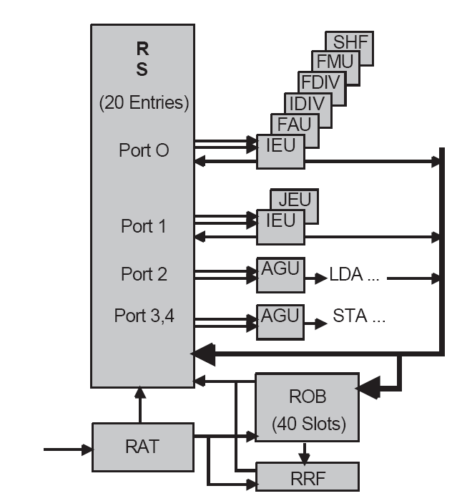

Intel Pentium Pro (P6) (1995)
Figure courtesy of Prof. Wen-mei Hwu, University of Illinois

Slide 42
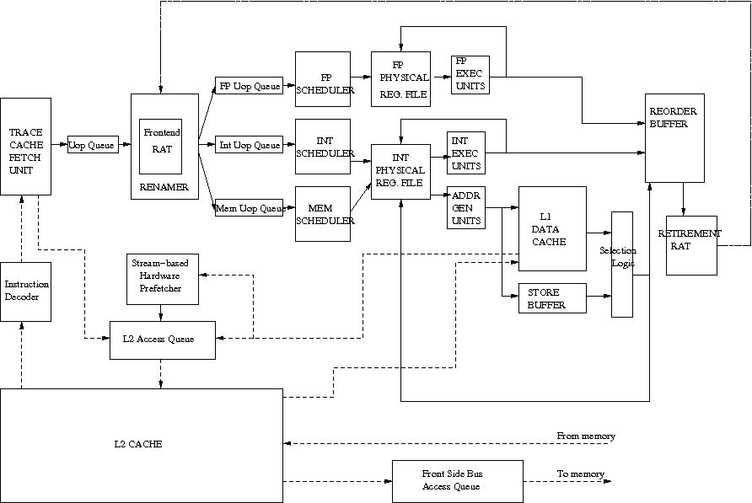

Intel Pentium 4 (Netburst) (2000)
[Hinton et al., “The Microarchitecture of the Pentium 4 Processor,” Intel Technology Journal, 2001.]

Slide 43
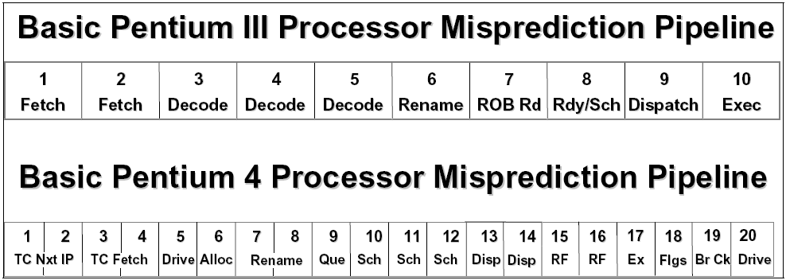
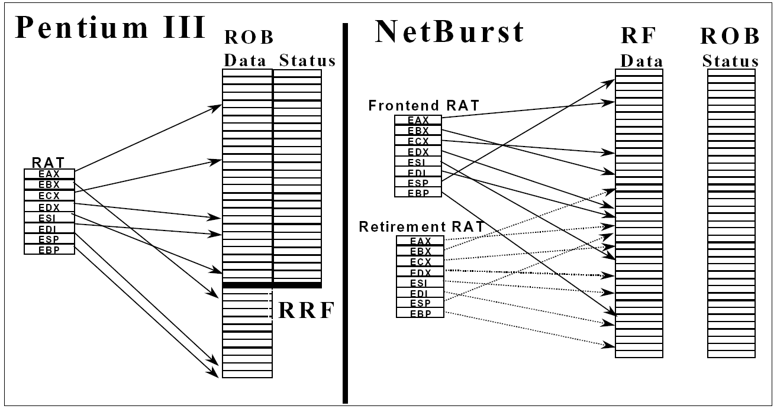
Pentium Pro vs. Pentium 4
Pointers to architectural
register values

Slide 44
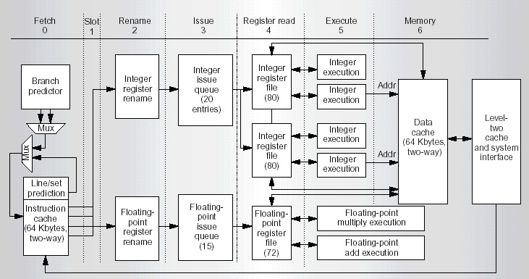
DEC Alpha 21264 (1996)
Kessler, “The Alpha 21264 Microprocessor,” IEEE Micro, March-April 1999.

Slide 45
Intel Nehalem (2008)
[source: Wikipedia]

Slide 46
Intel Skylake (2015)
[source: https://www.nextplatform.com/2017/08/04/drilling-xeon-skylake-architecture/ ]

Slide 47
Arm Cortex-A76 (2018)
[source: https://images.anandtech.com/galleries/6373/02_Cortex-A76%20Deep%20Dive%20Final_NoWM_12.png]

